Slide 1
Graph Neural Networks
1

Slide 2
Neural Networks
Thrives in situations where it is challenging to defined rules by hand
Algorithms that improve automatically through experience.
The algorithm has a (large) number of parameters whose values need to be learned from the data.
2
Notes:
Difference nueral networks and what to expect from them
Regression
Machine learning (ML) is the study of computer algorithms that improve automatically through experience.
Typically, the algorithm has a (large) number of parameters whose values are learned from the data.
Can be applied in situations where it is very challenging to defined rules by hand, e.g.,:
Face detection
Speech recognition
Stock prediction

Slide 3
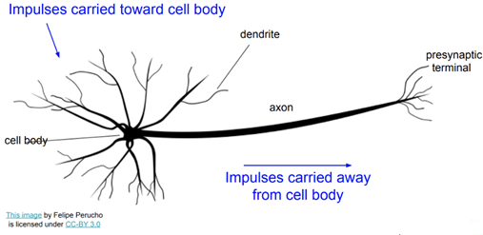
Nuerons
Inspired by neurons in biology.
http://cs231n.stanford.edu/slides/winter1516_lecture5.pdf
3
Notes:
Neural networks reflect the behavior of the human brain, allowing computer programs to recognize patterns and solve common problems in the fields of AI, machine learning, and deep learning
Mimicks the
Exciting new development in data analysis

Slide 4
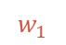


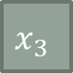
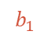
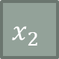
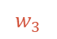
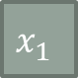
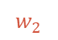
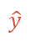
Perceptron
$$x_{1}$$
$$w_{1}$$
$$x_{2}$$
$$w_{2}$$
Output
Input
$$z$$
$$\hat{y}$$
$$w_{3}$$
$$x_{3}$$
$$b_{1}$$
+1
4
Notes:
A human brain has billions of neurons. Neurons are interconnected nerve cells in the human brain that are involved in processing and transmitting chemical and electrical signals. Dendrites are branches that receive information from other neurons.\
An artificial neural network is an interconnected group of nodes, inspired by a simplification of neurons in a brain.
1950s
An artificial neuron is a mathematical function based on a model of biological neurons, where each neuron takes inputs, weighs them separately, sums them up and passes this sum through a nonlinear function to produce output.

Slide 5
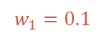
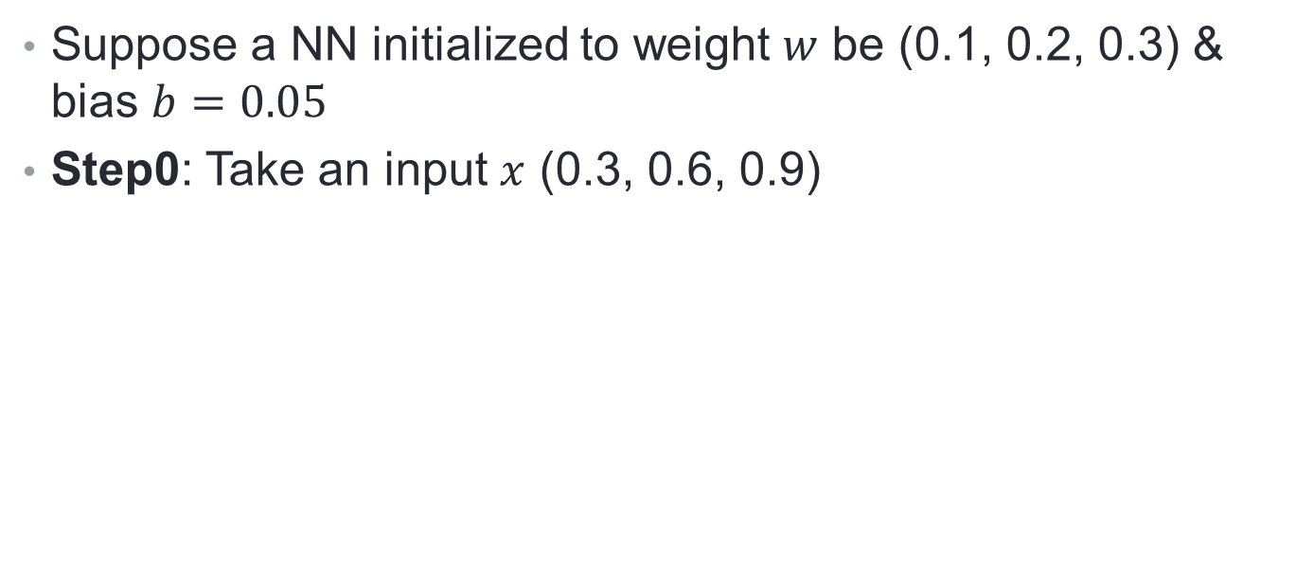



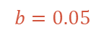

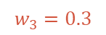

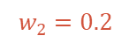
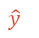
What does a Perceptron do? (1)
Suppose a NN initialized to weight $w$ be (0.1, 0.2, 0.3) & bias $b=0.05$
Step0: Take an input $x$ (0.3, 0.6, 0.9)
$$0.3$$
$$w_{1}=0.1$$
$$0.6$$
$$w_{2}=0.2$$
Output
Input
$$z$$
$$\hat{y}$$
$$w_{3}=0.3$$
$$0.9$$
$$b=0.05$$
+1
5
Notes:
A combination of linear transformation and nonlinear activation.

Slide 6
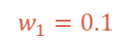
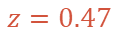
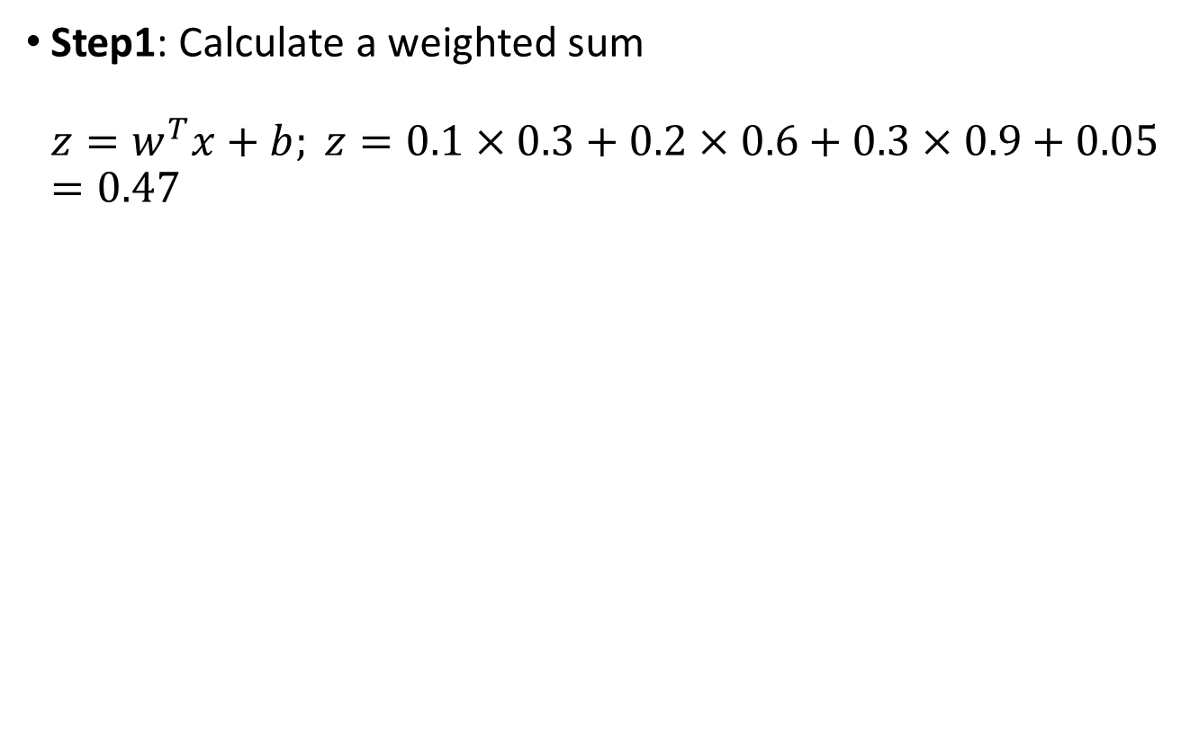
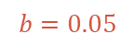
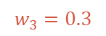

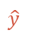
What does a Perceptron do? (2)
Step1: Calculate a weighted sum $z=w^{T}x+b; z=0.1×0.3+0.2×0.6+0.3×0.9+0.05=0.47$
$$0.3$$
$$w_{1}=0.1$$
$$0.6$$
$$w_{2}=0.2$$
Output
Input
$$z=0.47$$
$$\hat{y}$$
$$w_{3}=0.3$$
$$0.9$$
$$b=0.05$$
+1
6
Notes:
Net input function

Slide 7

What does a Perceptron do? (3)
Step2: Apply an activation function
$$0.3$$
$$w_{1}=0.1$$
$$0.6$$
$$w_{2}=0.2$$
Output
Input
$$z=0.47$$
$$\hat{y}$$
$$w_{3}=0.3$$
$$0.9$$
$$b=0.05$$
+1
7
Notes:
Why non linearity
Q: What is the power of a perceptron? Feed $z$ into the non-linear activation function Traditionally, the threshold value is represented either as the Greek letter theta (the symbol inside the circle in the picture above) or by a graphical symbol that looks like a square S:

Slide 8
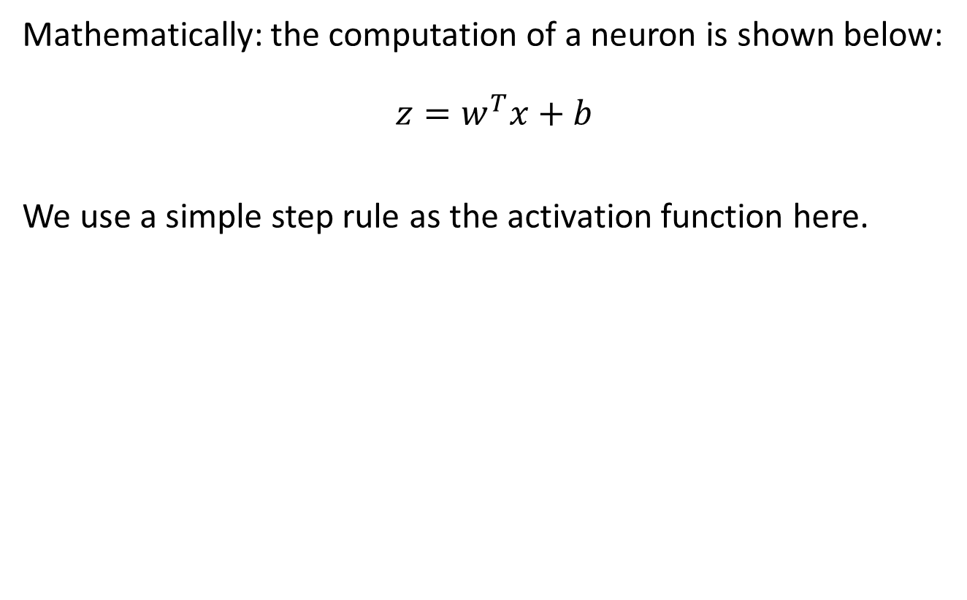
The Maths
Mathematically: the computation of a neuron is shown below:
$$z=w^{T}x+b$$
We use a simple step rule as the activation function here.
8
Notes:
1 – if wx _b > 0 0 otherwise

Slide 9
Neural Networks
Output Y is 1 if at least two of the three inputs are equal to 1.
9
Notes:
"Map" step: The master node takes the input, divides it into smaller sub-problems, and distributes them to worker nodes. A worker node may do this again in turn, leading to a multi-level tree structure. The worker node processes the smaller problem and passes the answer back to its master node.
Anaglous to the input and output

Slide 10
Neural Networks
10
Notes:
Is perceptron linear or nonlinear?
The Perceptron is a linear machine learning algorithm for binary classification tasks. It may be considered one of the first and one of the simplest types of artificial neural networks. It is definitely not “deep” learning but is an important building block.

Slide 11
Neural Networks
11
Model is an assembly of inter-connected nodes and weighted links
Output node sums up each of its input value according to the weights of its links
Compare output node against some threshold t
The sign function (activation function) outputs a value +1 if its argument is positive and -1 otherwise.
Perceptron Model
or
11

Slide 12
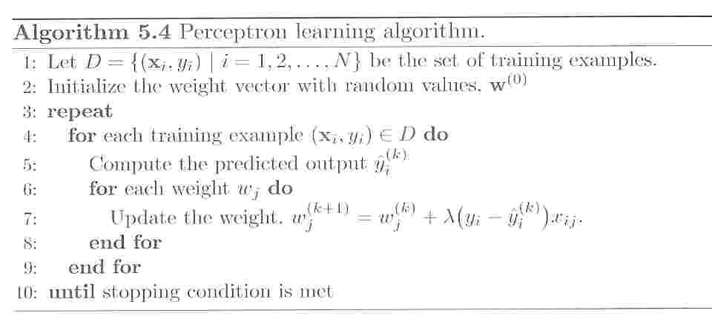
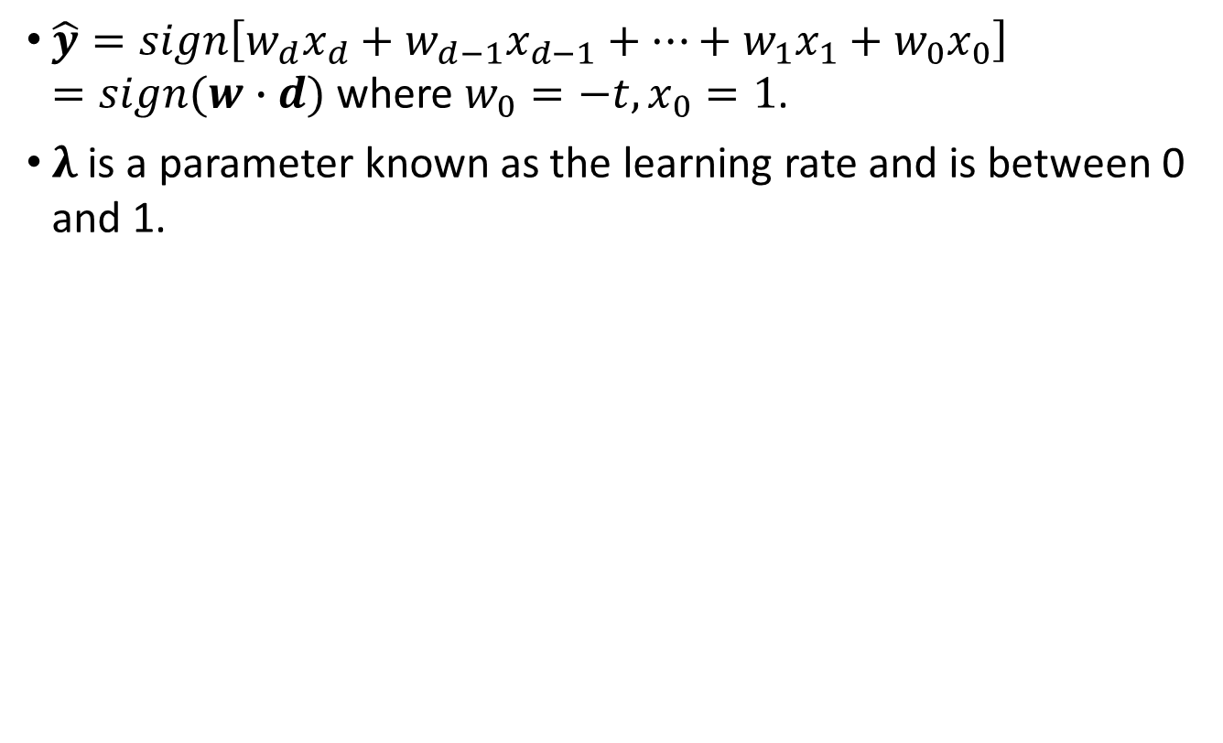
Perceptron Learning
$\hat{y}=sign\left[w_{d}x_{d}+w_{d−1}x_{d−1}+…+w_{1}x_{1}+w_{0}x_{0}\right]=sign(w∙d)$ where $w_{0}=−t, x_{0}=1$.
$λ$ is a parameter known as the learning rate and is between 0 and 1.
12
Notes:
he main feature of perceptrons is that they can be trained (or learn) to behave a certain way.

Slide 13
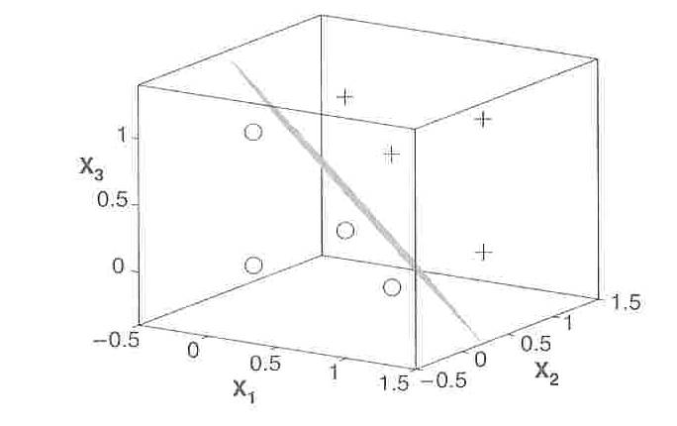
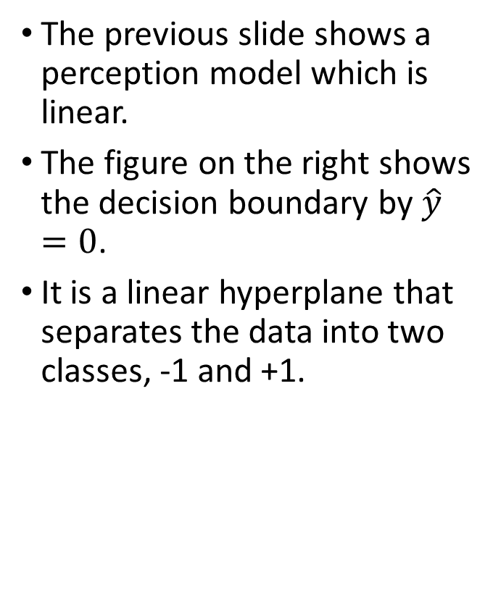
Perceptron Decision Boundary
The previous slide shows a perception model which is linear.
The figure on the right shows the decision boundary by $\hat{y}=0$.
It is a linear hyperplane that separates the data into two classes, -1 and +1.
13
Notes:
Single layer - Single layer perceptrons can learn only linearly separable patterns

Slide 14
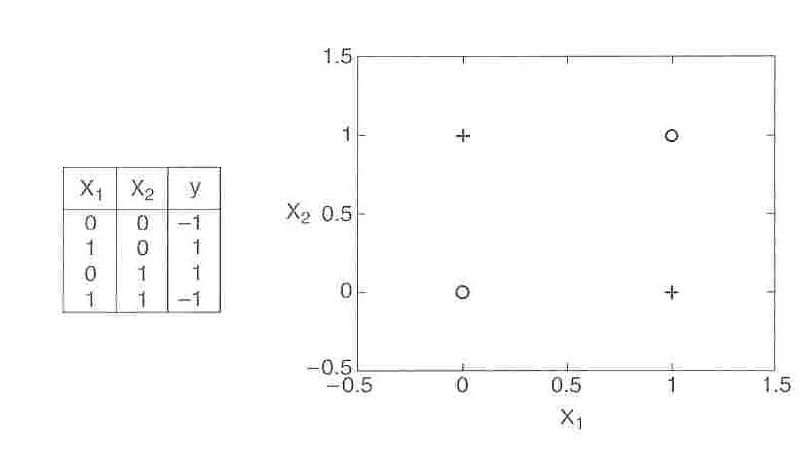
Nonlinear Hyperplane (XOR Problem)
Consider an example of nonlinearly separable data by the XOR function. The linear perception model cannot fid the solution for it.
14
Notes:
magine a neural network without the activation functions. In that case, every neuron will only be performing a linear transformation on the inputs using the weights and biases. Although linear transformations make the neural network simpler, but this network would be less powerful and will not be able to learn the complex patterns from the data.
The XOR, or “exclusive or”, problem is a classic problem in ANN research. It is the problem of using a neural network to predict the outputs of XOR logic gates given two binary inputs.
An XOR function should return a true value if the two inputs are not equal and a false value if they are equal.
It was first pointed out by Papert and Minsky that a single neuron cannot learn the XOR function since a single hyperplane (line in this case) cannot separate the output classes for this function definition

Slide 15
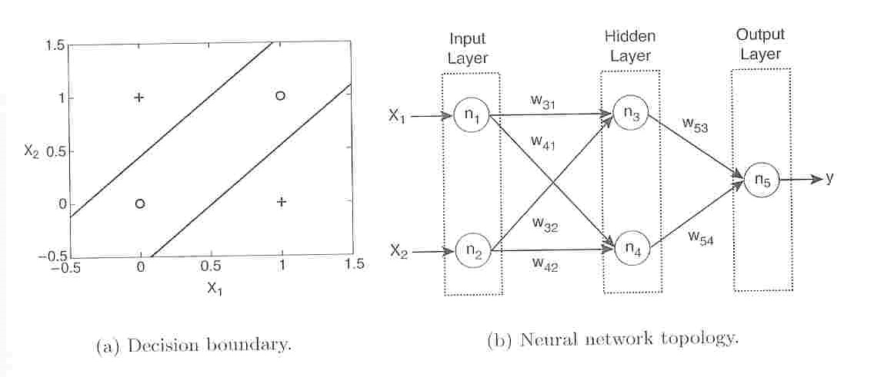
Two-Layers for XOR Problem
It uses a two-layer, feed-forward ANN.
15
Notes:
You solve it by adding a layer
For the XOR problem, 2 decision boundaries are needed to solve it using 2 inputs neurons, 2 hidden neurons, 1 output neuron. From the book "Neural Network Design" on page 84, the author says that "each neuron in the network divides the input spac intoo two regions.
n this case, two hyperplanes are generated, which can be used to solve the XOR problem.

Slide 16
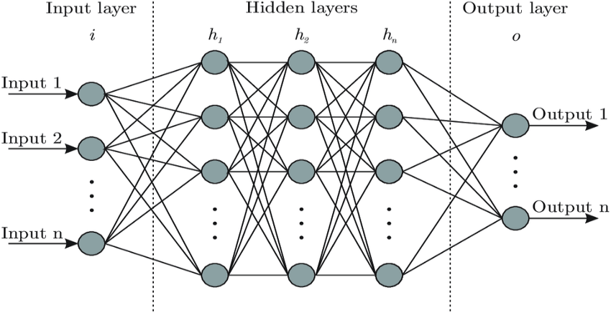
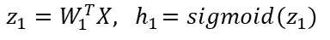
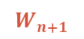
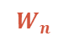
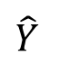
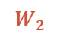
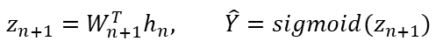
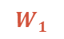
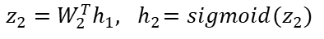
Classic Architecture
Multilayer Perceptrons (MLP)
$$W_{2}$$
$$W_{n}$$
$$W_{1}$$
Weight from each layer
$$W_{n+1}$$
$$\hat{Y}$$
p
$$z_{n+1}=W_{n+1}^{T}h_{n}, \hat{Y}=sigmoid(z_{n+1})$$
$$z_{1}=W_{1}^{T}X, { h}_{1}=sigmoid(z_{1})$$
$$z_{2}=W_{2}^{T}h_{1}, { h}_{2}=sigmoid(z_{2})$$
16
Notes:
Artificial Neural Network tries to mimic a similar behavior. The network you see below is a neural network made of interconnected neurons. Each neuron is characterized by its weight, bias and activation function.

Slide 17
Classic Architecture
Training ANN means learning the weights of the neurons
This is a feed-forward ANN.
17

Slide 18
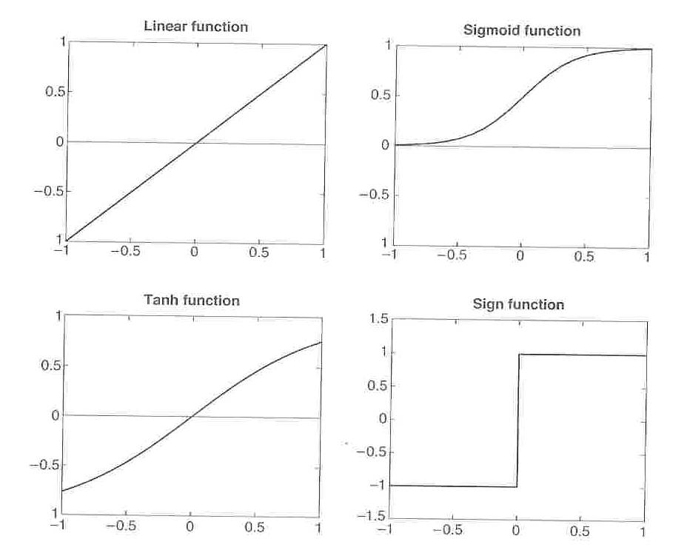
Activation Functions
18
Notes:
It is one of the most widely used non-linear activation function. Sigmoid transforms the values between the range 0 and 1.
the tanh function is very similar to the sigmoid function. The only difference is that it is symmetric around the origin. The range of values in this case is from -1 to 1. Thus the inputs to the next layers will not always be of the same sign.
Introduces non-linearity to classify more complicated mathematical expressions such as XOR

Slide 19
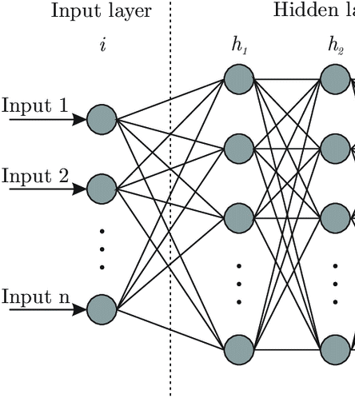
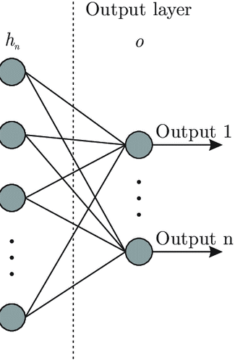
Increased Expressive Power
From Perceptrons to NN
Perceptrons are a basic unit of a neural network.
1-layered neural network on the right
Structure:
Input layer, output layer,
Middle are hidden layers.
p
19

Slide 20
Design Issues in NN Learning
The number of nodes in the input layer should be determined.
Generally, the number of nodes in the output layer can be 2 for binary classification, and k for k-class classification.
The network topology
The number of hidden layers and hidden nodes
Feed-forward or recurrent network
Activation function
Weights and biases need to be initialized
20

Slide 21
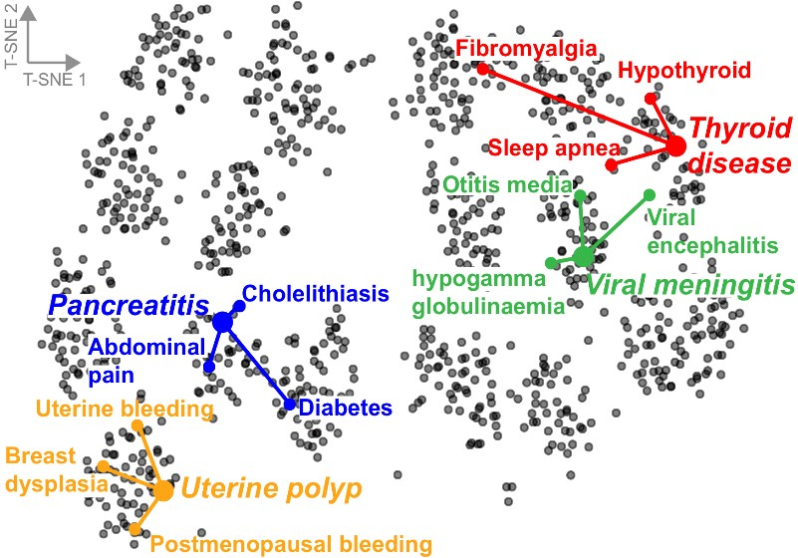
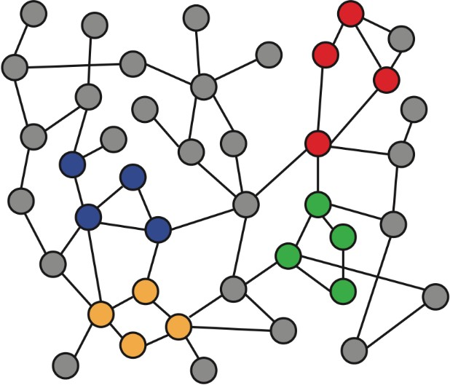
Recap: Node Embeddings
Intuition: Map nodes to 𝑑-dimensional embeddings such that similar nodes in the graph are embedded close together
f ( )=
Input graph 2D node embeddings
21
Notes:
How to learn mapping function 𝒇?

Slide 22
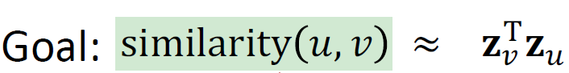
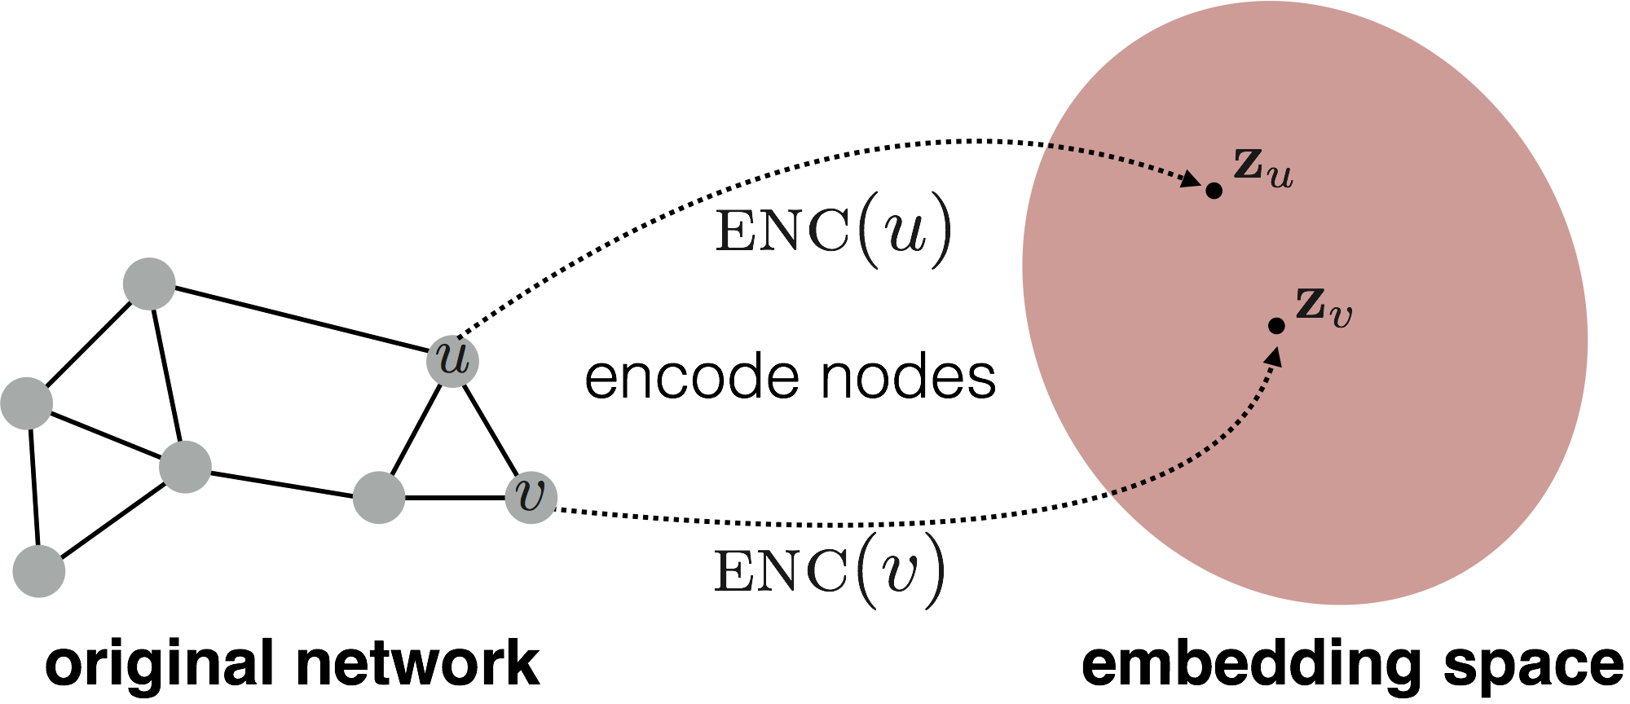
Recap: Node Embeddings
Need to define!
Input network
d-dimensional embedding space
22

Slide 23
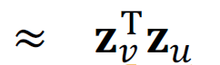
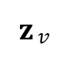
Recap: Two Key Components
Encoder: maps each node to a low-dimensional vector
d-dimensional embedding
ENC (𝑣) =
𝐳$v$
node in the input graph
Similarity function: specifies how the relationships in vector space map to the relationships in the original network
similarity (𝑢, 𝑣)
Similarity of 𝑢 and 𝑣 in the original network
Decoder
dot product between node embeddings
23

Slide 24


Recap: “Shallow” Encoding
Simplest encoding approach: encoder is just an embedding-lookup
embedding vector for a
embedding matrix
specific node
𝐙 =
Dimension/size of embeddings
one column per node
24

Slide 25
Recap: “Shallow” Encoding
Limitations of shallow embedding methods:
𝑶(|𝑽|) parameters are needed:
No sharing of parameters between nodes
Every node has its own unique embedding
Inherently “transductive”:
Cannot generate embeddings for nodes that are not seen during training
Do not incorporate node features:
Many graphs have features that we can and should leverage
25

Slide 26
Today: Deep Graph Encoders
Today: We will now discuss deep methods based on graph neural networks (GNNs):
multiple layers of
non-linear transformations based on graph structure
ENC 𝑣 =
26

Slide 27
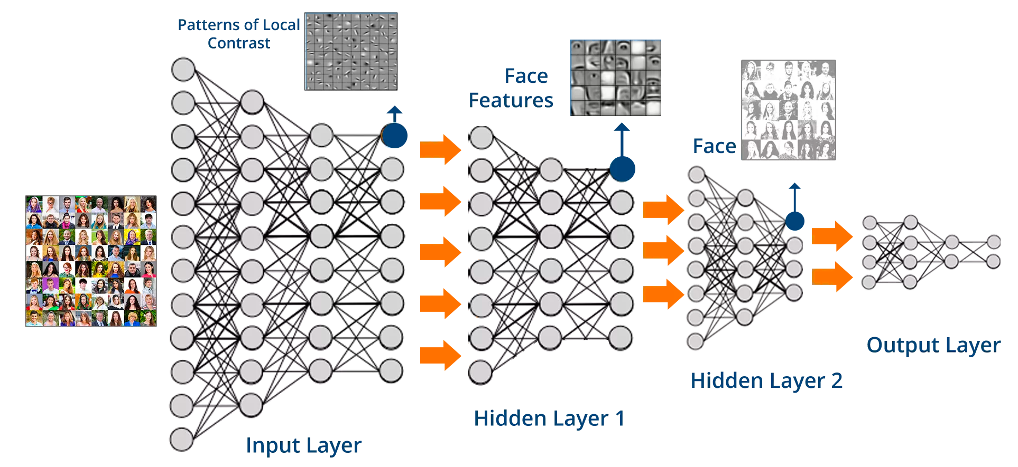
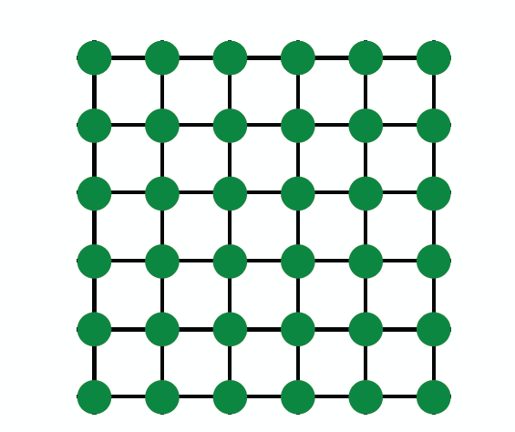
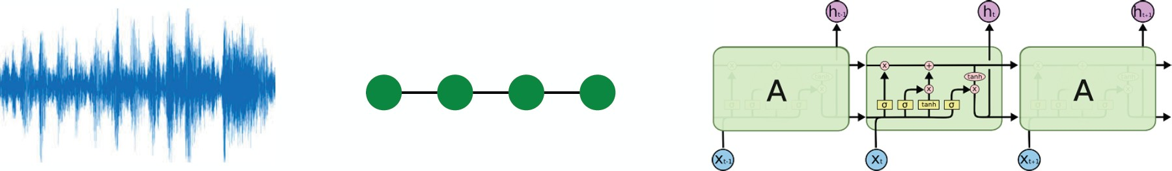
Modern ML Toolbox
Images
Text/Speech
Modern deep learning toolbox is designed for simple sequences & grids
27

Slide 28
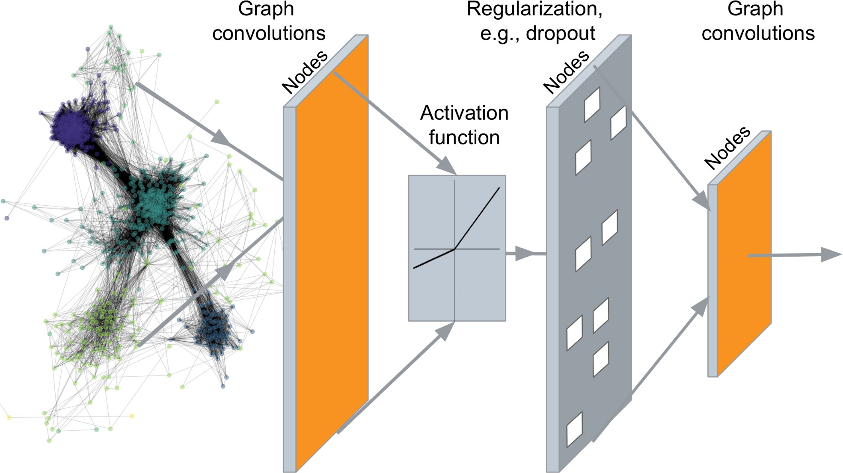
Deep Graph Encoders
…
Output: Node embeddings. Also, we can embed subgraphs, graphs
28
Notes:
A set of node embeddings?

Slide 29



But networks are far more complex!
Arbitrary size and complex topological structure (i.e., no spatial locality like grids)
vs.
Text
Networks Images
No fixed node ordering or reference point
Often dynamic and have multimodal features
29

Slide 30
Tasks on Networks
Tasks we will be able to solve:
Node classification
Predict a type of a given node
Link prediction
Predict whether two nodes are linked
Community detection
Identify densely linked clusters of nodes
Network similarity
How similar are two (sub)networks
30

Slide 31
Setup
Assume we have a graph 𝑮:
𝑉 is the vertex set
𝑨 is the adjacency matrix (assume binary)
𝑿 ∈ ℝ^{:m×|V|} is a matrix of node features
𝑣: a node in 𝑉; 𝑁 (𝑣): the set of neighbors of 𝑣.
Node features:
Social networks: User profile, User image
When there is no node feature in the graph dataset:
Indicator vectors (one-hot encoding of a node)
Vector of constant 1: [1, 1, …, 1]
31
Notes:
Biological networks: Gene expression profiles, gene functional information

Slide 32



A Naïve Approach
Join adjacency matrix and features
Feed them into a deep neural net:
• Done
A B C D E
0 1 1 1 0
1 0 0 1 1
1 0 0 1 0
1 1 1 0 1
0 1 0 1 0
Feat
A B C D E
1 0
0 0
0 1
1 1
1 0
A B
?
E
C
D
○ Issues with this idea:
Issues with this idea:
𝑂(|𝑉|) parameters
Not applicable to graphs of different sizes
Sensitive to node ordering
32

Slide 33


CNN on an image:
Goal is to generalize convolutions beyond simple lattices Leverage node features/attributes (e.g., text, images)
33

Slide 34

What about Graphs?
34
Talk on Deep learning on graphs: successes, challenges by Michael Bronstein
Notes:
in this field, you see that this is really one of the prominent keywords. Now what makes graph
neural networks so interesting, and so similar but at the same time different from the traditional
deep running architectures. So let's look at classical CNNs, so the input in this
case is agreed, so the image is a function defined on a grid. And if we want to do
operations on the grid like convolutions basically I need to look at each pixel and its neighbors
and what conventional neural networks do, they aggregate the features or the values in the pixels
of the neighbors by just simply multiplying them by some weights. Now I can do the same thing in

Slide 35

What about Graphs?
35
Talk on Deep learning on graphs: successes, challenges by Michael Bronstein
Notes:
Now I can do the same thing in
the graph. Right! So the neighbors will be the nodes that are attached by edges to some node.
So, so far, it looks exactly the same thing but

Slide 36

What about Graphs?
36
Talk on Deep learning on graphs: successes, challenges by Michael Bronstein
Notes:
one thing to know that in agreed when I move to
a different position I have a constant number of neighbors on the graph. I might have a very
that in agreed when I move to
a different position I have a constant number of neighbors on the graph. I might have a very
different number of labels, so if you think of social networks some nodes are extremely popular, they might have millions of neighbors, some just a few. Right! So the degree of the node might be
very different.

Slide 37

What about Graphs?
37
Talk on Deep learning on graphs: successes, challenges by Michael Bronstein
Notes:
Another thing to note is that in a grid I have a fixed ordering of the neighbors.
I can always talk about a node to the left or a node to the right and this allows me actually to
apply the same weight to the same order of the nodes, so I can really share the weights. In
case of graphs, the ordering of the nodes can be completely arbitrary. So I don't have an ordering
of the nodes, at least, not a canonical one. And this actually makes a graph neural networks quite
different

Slide 38







Graphs look like this
or this
No fixed notion of locality or sliding window on the graph
Graph is permutation invariant
38

Slide 39




Convolutional layer with 3x3 filter
Image Graph
Idea: transform information at the neighbors and combine it:
Transform “messages” $h_{i}$from neighbors: $W_{i}h_{i}$
Add them up:
39

Slide 40



A Computation Graph
𝑖
𝑖
Determine node computation graph
Propagate and transform information
Learn how to propagate information across the graph to compute node features
40
Notes:
Graph convolutional networks

Slide 41
Aggregate Neighbors
Key idea: Generate node embeddings based on local network neighborhoods
A
TARGET NODE
B
B
C
A
B
A
C
A
C
F
E
D
F
E
D
INPUT GRAPH
A
41
Notes:
Initially each node target node – wants to know key idea is that they want to learn both the structure and the feature

Slide 42
Aggregate Neighbors
Intuition: Nodes aggregate information from their neighbors using neural networks
A
TARGET NODE
B
B
C
A
B
A
C
A
C
F
E
D
F
E
D
INPUT GRAPH
A
Neural networks
42

Slide 43


Aggregate Neighbors
Intuition: Network neighborhood defines a computation graph
Every node defines a computation graph based on its neighborhood!
43

Slide 44







Deep: Many Layers
Model can be of arbitrary depth:
Nodes have embeddings at each layer
Layer-0 embedding of node 𝑢 is its input feature, 𝑥_{𝑢}
Layer-𝑘 embedding gets information from nodes that are K hops away
TARGET NODE
B
A
C
F
D
E
INPUT GRAPH
44
Notes:
After each n x
Dimensionality of the embedding might change
H(0) = X H(L) = Z

Slide 45
Neighborhood Aggregation
Neighborhood aggregation: Key distinctions are in how different approaches aggregate information across the layers
A
?
TARGET NODE
B
B
C
What is in the box?
A
A
C
B
?
C
?
A
E
F
D
F
E
?
D
INPUT GRAPH
A
45

Slide 46
Neighborhood Aggregation
Basic approach: Average information from neighbors and apply a neural network
(1) average messages from neighbors
A
TARGET NODE
B
B
C
A
B
A
C
A
C
F
E
D
F
E
D
INPUT GRAPH
(2) apply neural network
A
46

Slide 47

A GNN Layer
GNN Layer = Message + Aggregation
Different instantiations under this perspective
GCN, GraphSAGE, GAT, …
(2) Aggregation
(1) Message
TARGET NODE
B
GNN Layer 1
A
C
F
D
E
INPUT GRAPH
47
Notes:
A Closer look at a Single Layer of a GNN

Slide 48

A Single GNN Layer
48

Slide 49

Message Computation
49

Slide 50

Message Aggregation
50

Slide 51

Message Aggregation Issue
51
Notes:
What if without self loop?
Can still work, it’s task dependent
However – it’s generally put in by default

Slide 52

A Single GNN Layer
52

Slide 53

Activation (Non-linearity)
53

Slide 54

Classical GNN Layers: GCN
54

Slide 55

Classical GNN Layers: GCN
55

Slide 56


The Maths: Deep Encoder
Basic approach: Average neighbor messages and apply a neural network
56

Slide 57


Model Parameters
We can feed these embeddings into any loss function
and run SGD to train the weight parameters
$h_{v}^{l}$:the hidden representation of node 𝑣 at layer 𝑙
$W_{k}$:weight matrix for neighborhood aggregation
$B_{k}$ : weight matrix for transforming hidden vector of self
57

Slide 58

Matrix Formulation
58
Notes:
Graph level

Slide 59

Matrix Formulation
Re-writing update function in matrix form:
59
Notes:
normalization

Slide 60




Example
Compute the output of the first graph convolutional layer based on the above formula
60
Notes:
Row are the nodes
D is the dimension
N xd matrix
Too extreme, gauss distribution

Slide 61





Example
The matrix $D^{−1}:$
Adjacent matrix A:
The matrix $D^{−1}A:$
61

Slide 62





Example
Matrix $H0$ :
Matrix $D^{−1}A$ :
Matrix $D^{−1}AH$ :
62

Slide 63





Example
Matrix $D^{−1}AH$ :
Matrix $W0$ :
Matrix $D^{−1}AHW^{T}$ :
63

Slide 64






Example
Matrix $B0$ :
Matrix $H0$ :
Matrix $HB^{T}$ :
64

Slide 65




Example
Matrix $D^{−1}AHW^{T}$ :
Matrix $HB^{T}$ :
Matrix $D^{−1}AHW^{T}+HB^{T}$ :
65

Slide 66



Example
Matrix $D^{−1}AHW^{T}+HB^{T}$ :
Matrix $σ(D^{−1}AHW^{T}+HB^{T})$ :
66
Notes:
Which are the embeddings final

Slide 67

Train a GNN
Node embedding $z_{v}$ is a function of input graph
Supervised setting: we want to minimize the loss ℒ:
min ℒ(𝒚, 𝑓$(z_{v}$ ))
Θ
𝒚: node label
ℒ could be L2 if 𝒚 is real number, or cross entropy if 𝒚 is categorical
Unsupervised setting:
No node label available
Use the graph structure as the supervision!
67

Slide 68

Supervised Training
Directly train the model for a supervised task (e.g., node classification)
Safe or toxic drug?
Safe or toxic drug?
E.g., a drug-drug interaction network
68
Notes:
Directly train the model for a supervised task (e.g., node classification)

Slide 69


Supervised Training
Directly train the model for a supervised task (e.g., node classification)
- Use cross entropy loss
69

Slide 70


Unsupervised Training
“Similar” nodes have similar embeddings
Where $y_{u,v}$= 1 when node 𝑢 and 𝑣 are similar
CE is the cross entropy
DEC is the decoder such as inner product
Node similarity can be anything from previous lectures, e.g., a loss based on:
Random walks (node2vec, DeepWalk, struc2vec)
Node proximity in the graph
70

Slide 71


Model Design: Overview
(1) Define a neighborhood aggregation function
𝒛_{A}
(2) Define a loss function on the embeddings
71

Slide 72

Model Design: Overview
(3) Train on a set of nodes, i.e., a batch of compute graphs
72

Slide 73
Model Design: Overview
(4) Generate embeddings for nodes as needed
Even for nodes we never trained on!
73

Slide 74






























Inductive Capability
The same aggregation parameters are shared for all nodes:
The number of model parameters is sublinear in
|𝑉| and we can generalize to unseen nodes!
B
shared parameters
$W_{l}$
shared parameters
$$B_{l}$$
A
C
F
D
E
INPUT GRAPH
Compute graph for node A
Compute graph for node B
74

Slide 75



Inductive Capability: New Graphs
Train on one graph
Generalize to new graph
Inductive node embedding Generalize to entirely unseen graphs
E.g., train on protein interaction graph from model organism A and generate embeddings on newly collected data about organism B
75

Slide 76



Inductive Capability: New Nodes
Train with snapshot
New node arrives
Generate embedding for new node
Many application settings constantly encounter previously unseen nodes:
E.g., Reddit, YouTube, Google Scholar
Need to generate new embeddings “on the fly”
76

Slide 77






Stacking GNN Layers
How to connect GNN layers into a GNN?
1. Stack layers sequentially
TARGET NODE
B
GNN Layer 1
A
C
D
E
F
INPUT GRAPH
(3) Layer connectivity
GNN Layer 2
77

Slide 78

Stacking GNN Layers
78

Slide 79
An Over-smoothing Problem
The Issue of stacking many GNN layers
GNN suffers from the over-smoothing problem
The over-smoothing problem: all the node embeddings converge to the same value
This is bad because we want to use node embeddings to differentiate nodes
Why does the over-smoothing problem happen?
79

Slide 80



Receptive Field of a GNN
Receptive field: the set of nodes that determine the embedding of a node of interest
In a 𝑲-layer GNN, each node has a receptive field of 𝑲-hop neighborhood
Receptive field for 1-layer GNN
Receptive field for 2-layer GNN
Receptive field for 3-layer GNN
80

Slide 81



Receptive Field of a GNN
Receptive field overlap for two nodes
The shared neighbors quickly grows when we increase the number of hops (num of GNN layers)
1-hop neighbor overlap Only 1 node
2-hop neighbor overlap About 20 nodes
3-hop neighbor overlap Almost all the nodes!
81

Slide 82
Receptive Field &Over-smoothing
We can explain over-smoothing via the notion of receptive field
We knew the embedding of a node is determined by its receptive field
If two nodes have highly-overlapped receptive fields, then their embeddings are highly similar
Stack many GNN layers → nodes will have highly- overlapped receptive fields → node embeddings will be highly similar → suffer from the over- smoothing problem
Next: how do we overcome over-smoothing problem?
82

Slide 83


Over-smoothing
Notes:
Typically 2 -4 layers

Slide 84

Design GNN Layer Connectivity
What do we learn from the over-smoothing problem?
Lesson 1: Be cautious when adding GNN layers
Unlike neural networks in other domains (CNN for image classification), adding more GNN layers do not always help
Step 1: Analyze the necessary receptive field to solve your problem. E.g., by computing the diameter of the graph
Step 2: Set number of GNN layers 𝐿 to be a bit more than the receptive field we like. Do not set 𝑳 to be unnecessarily large!
84

Slide 85


Expressive Power for Shallow GNNs
Question: How to enhance the expressive power of a GNN, if the number of GNN layers is small?
Solution 1: Increase the expressive power within each GNN layer
In our previous examples, each transformation or aggregation function only include one linear layer
We can make aggregation / transformation become a deep neural network!
If needed, each box could include a 3-layer MLP
(2) Aggregation
(1) Transformation
85

Slide 86
Learning Outcome
Generate node embeddings by aggregating neighborhood information
Key distinctions are in how different approaches aggregate information across the layers
Acknowledgement: Jure Leskovec, Stanford University
86

